Slide 1
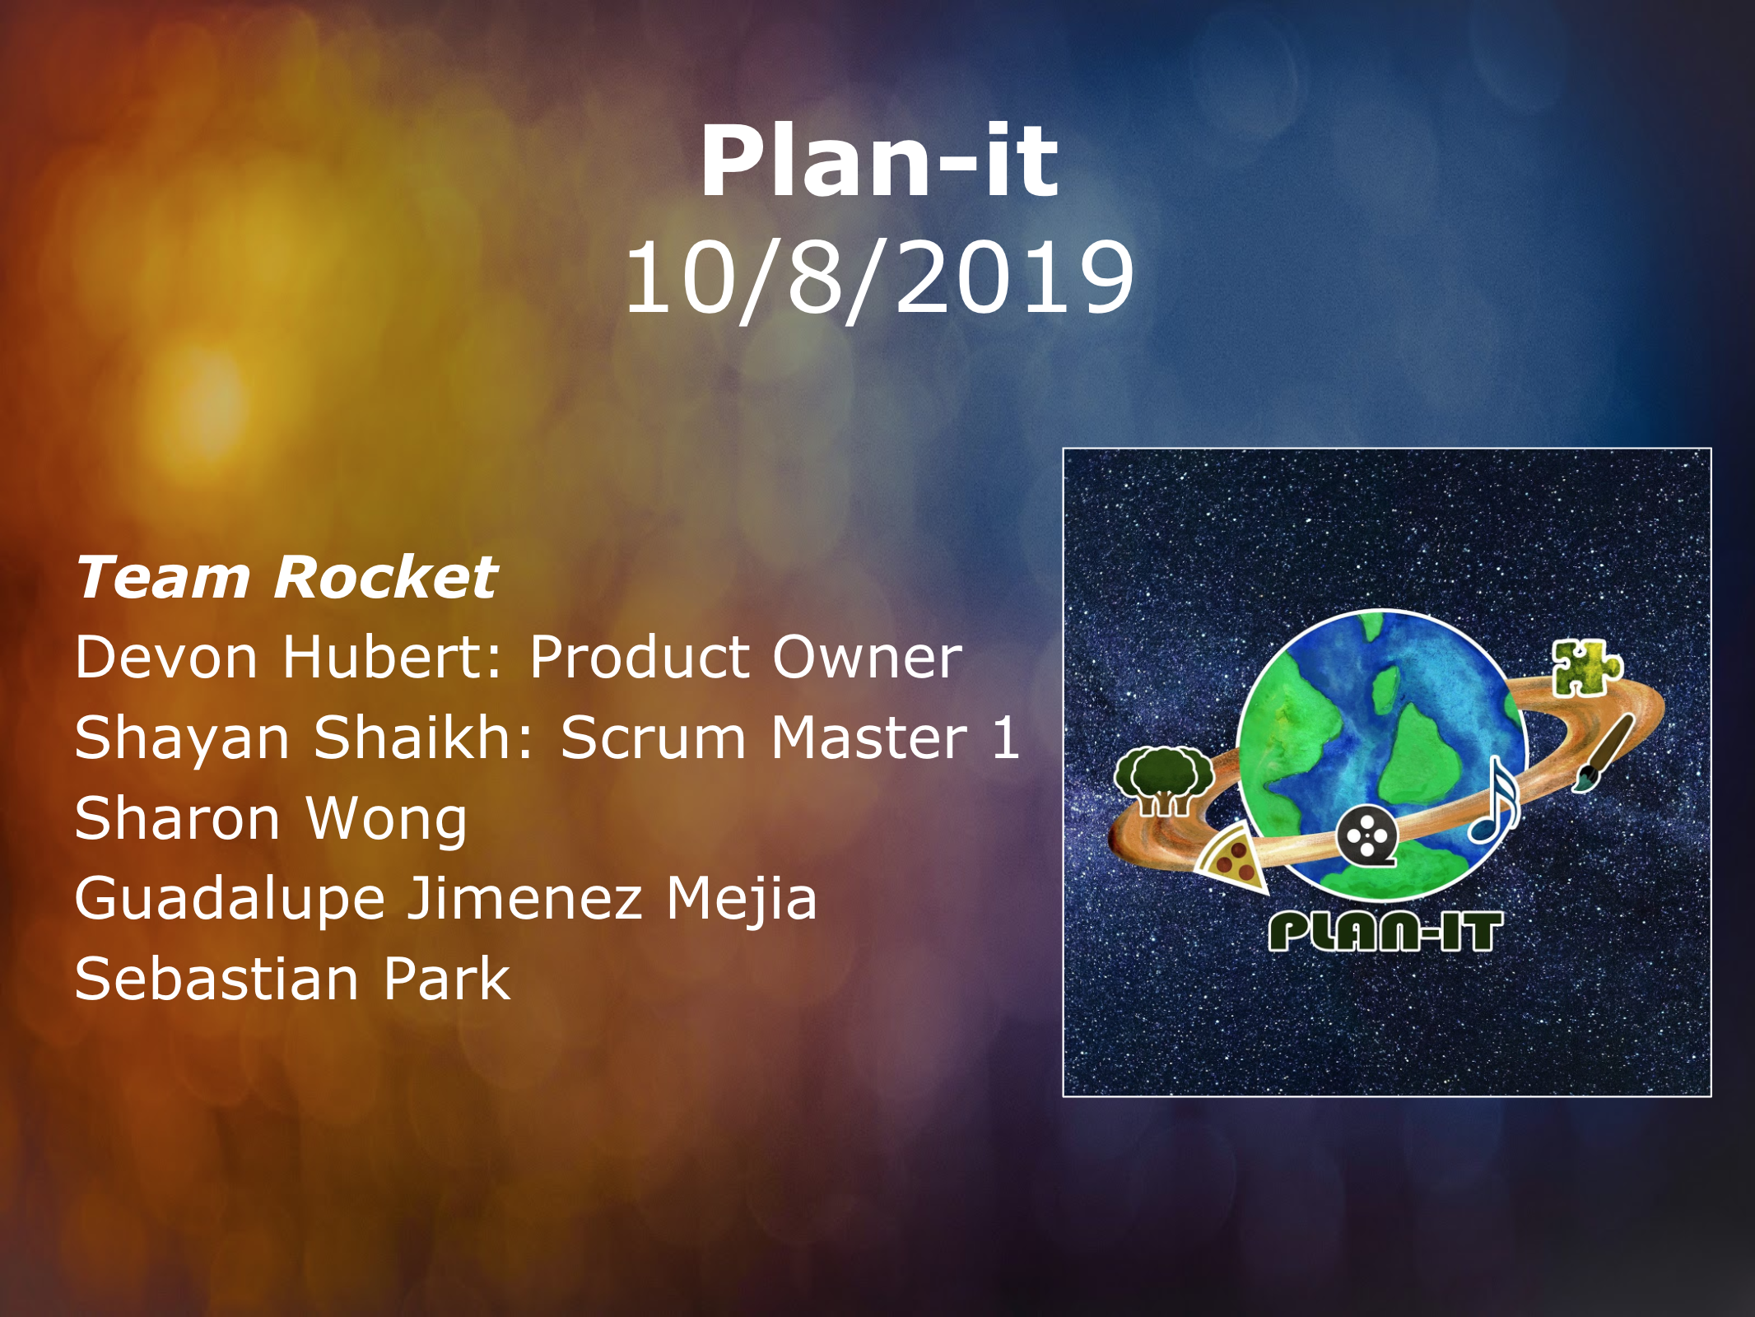

Slide 2
Plan-it
Generates a customized activity plan that fits the amount of time and money the user has available.
High Level Goals:
Allow the user to run the program easily through an intuitive user interface.
Prompt the user to enter in basic information about their favorite activities, which will be stored on the user’s computer for future reference.
Allow the user to enter in the amount of time and money they have available, and generate activity plans that fit their schedule and budget.

Slide 3
Sprint 1
High level goal:
Create an intuitive user interface for easy data entry.
User story 1: (5 story points)
As a user, I want an interface that allows me to input data into text fields and submit them to be stored, as well as a “generate activity plan” button, so I can easily interact with the application.
User story 2: (5 story points)
As product owner/developer, I want the application to prompt and allow users to enter in activities they enjoy, along with the maximum length, ideal length, and maximum cost of each activity, so that these activities can become the basis of the user’s future activity plans.

Slide 4
Sprint 2
High level goal:
Store and load user data, and create the basis of an algorithm that draws from this data to create an activity plan.
User story 3: (5 story points)
As a developer, I want database data to be stored on the user’s computer, so that the user doesn’t need to enter the same information every time they use the application.
User story 4: (13 story points)
As product owner/developer, I want the main algorithm of the code to draw from the user’s saved database of activities, and fill up the given time with activities that fit within the given cost, so that the user will have a list of activities they can do.

Slide 5
Sprint 3
High level goal:
Create a smarter algorithm that will generate optimized activity plans, and allow the user to save their favorite plans.
User story 5: (5 story points)
As a user, I want the final list to be printable/saveable, including the cost/time for each activity, as well as the total time and cost, so I can take my plan on the go.
User story 6: (13 story points)
As product owner, I want the main algorithm to make smart decisions that maximize the user’s experience, and minimize cost when possible, so that the user will have a better overall experience.

Slide 6
Sprint 4
High level goal:
Allow the user to give feedback on the generated plans, and set up the algorithm to adapt to this data.
User story 7: (5 story points)
As product owner, I want the user to be able to rate their experience with each activity, updating the database for future reference, so that activity plans will improve the more that the user uses the application.
User story 8: (8 story points)
As a developer, I want to expand the database to include user feedback data, and incorporate this data into the decision algorithm so that the algorithm makes better choices.

Slide 7
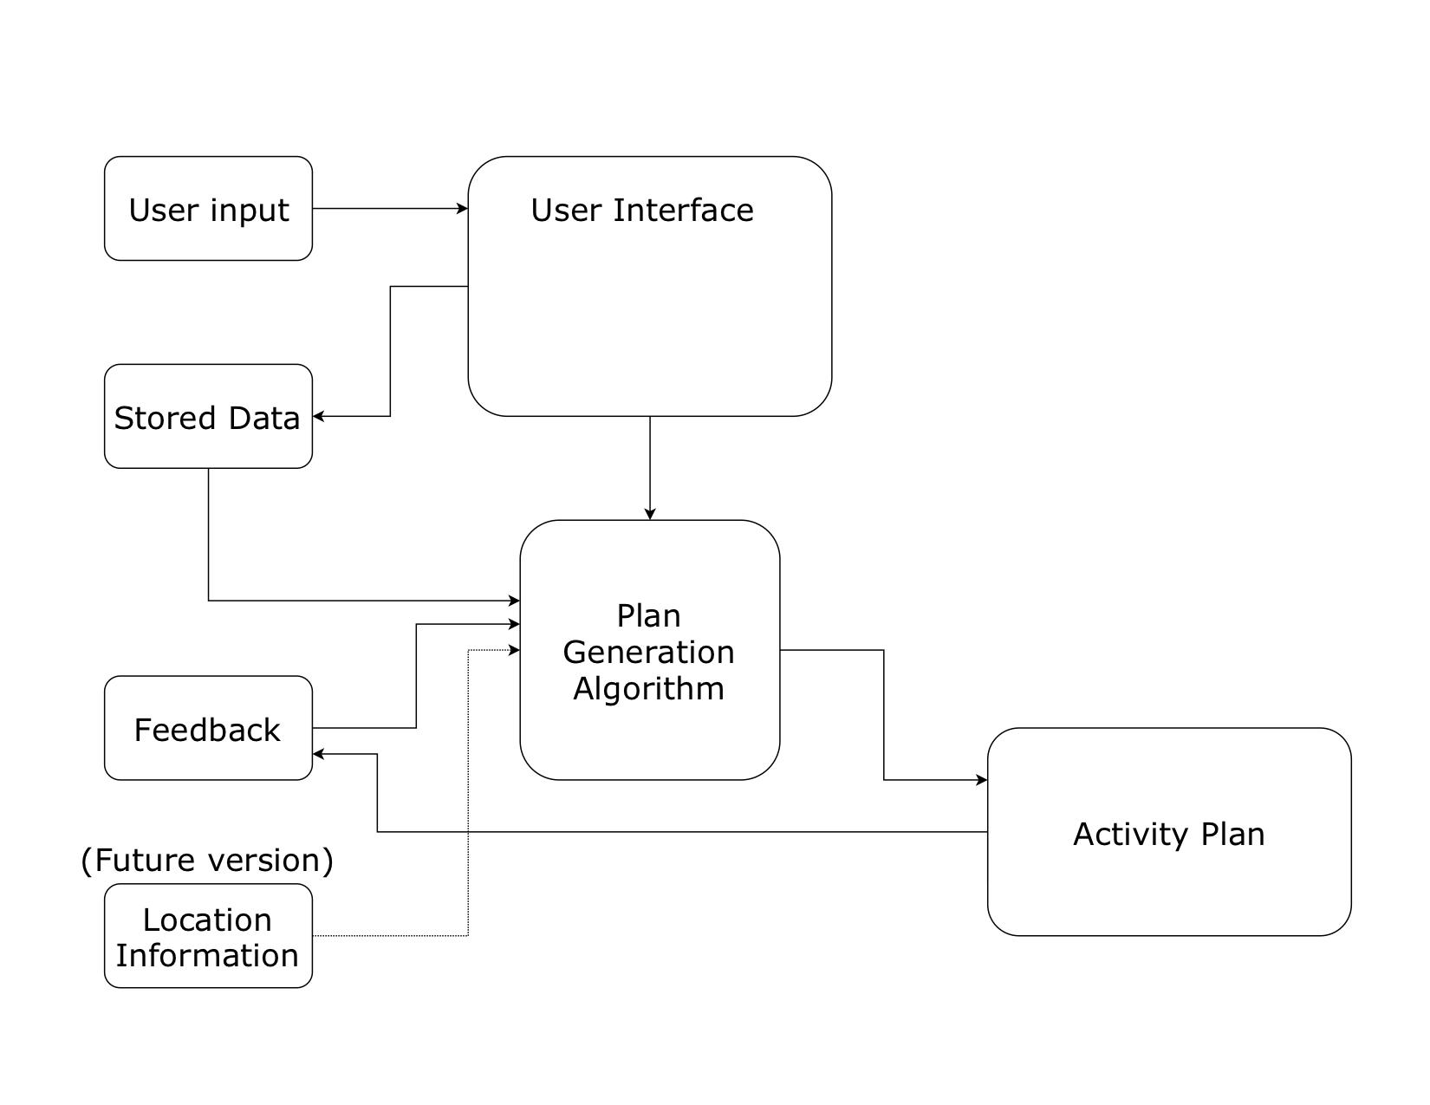
Architecture

Slide 8
Challenges
Challenge 1: Using Agile project management.
Challenge 2: User interface design.
Challenge 3: Creating the core decision algorithm.

Slide 9
Technologies
Version control: Git/GitHub
Programming Language: Java
Graphics libraries: java.awt, java.swing, etc.
Tech for future versions:
Google Maps API, HTML, CSS, JS, and PHP.

Slide 10
Minimum Viable Product:
User can enter in activity information to an interface, and easily generate an activity plan from this data that fits the timeframe and budget they provide.

